Slide 1

Cryptocurrency market relation with news and social media
How a mention on a coin impacts its volatility?
Heloisa Dutcosky
New York, November 1st 2018

Slide 2
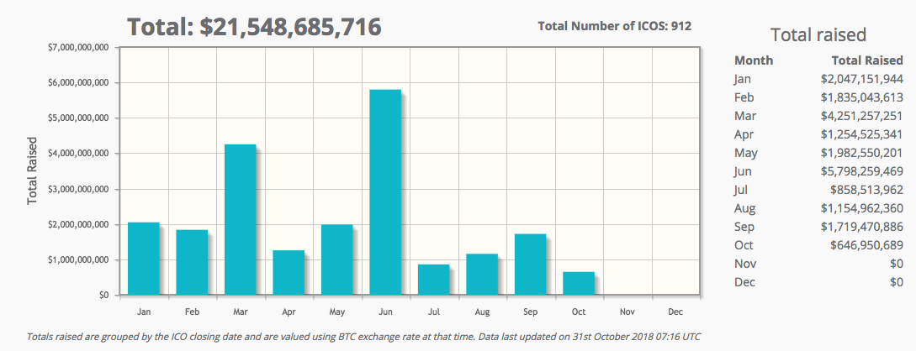






Cryptocurrencies have already raised $21B US in 2018 through ICOs, yet very few governments have seriously discussed it
1
Context
Context overview
ICO’s stats 2018
Governments news samples
Source: CoinSchedule, Cointelegraph
Notes:
https://www.coinschedule.com/stats.html
https://icobench.com/stats

Slide 3
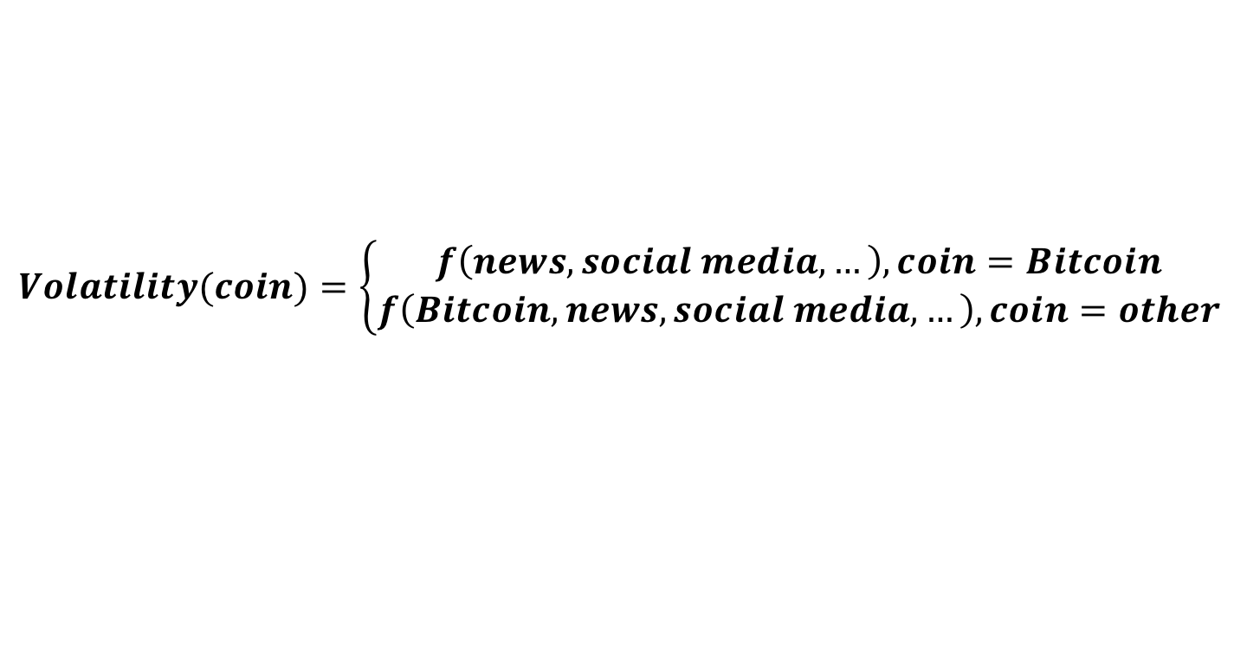
A coin’s value is mainly defined by its network extension and the spe-culation on it, depending on adoption, restriction and its likelihoods
1
Context
Cryptocurrency value
$$Price(coin)=f(Network, Speculation)$$
$$Network(coins)=f(adoption, restriction, regulation)$$
$$Speculation(coins)=f(p\left(adoption\right), p(restriction), influencers, other coins)$$
$$Volatility(coin)=\left\{\begin{aligned}f\left(news,social media, …\right), coin=Bitcoin \\ f\left(Bitcoin,news,social media, …\right), coin=other\end{aligned}\right.$$
$$News impact=f(source, views,content)$$
$$Social media impact=f(user, views, comments,content)$$

Slide 4
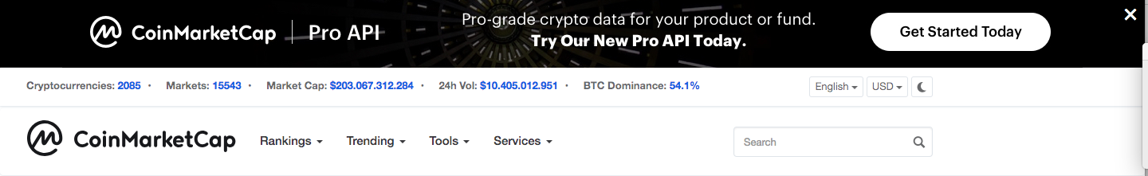
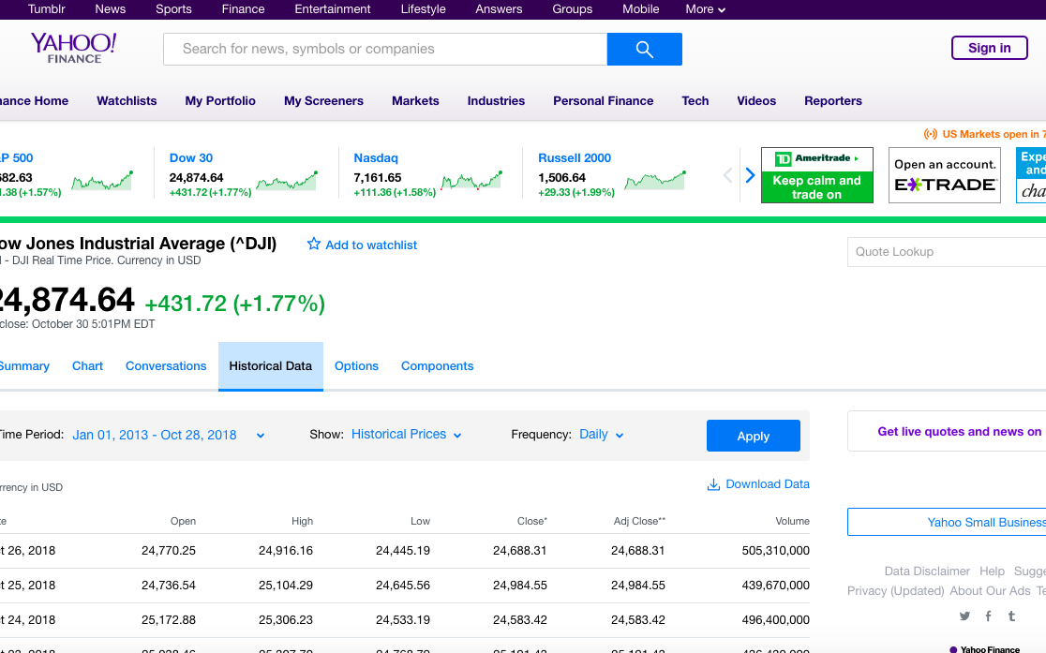
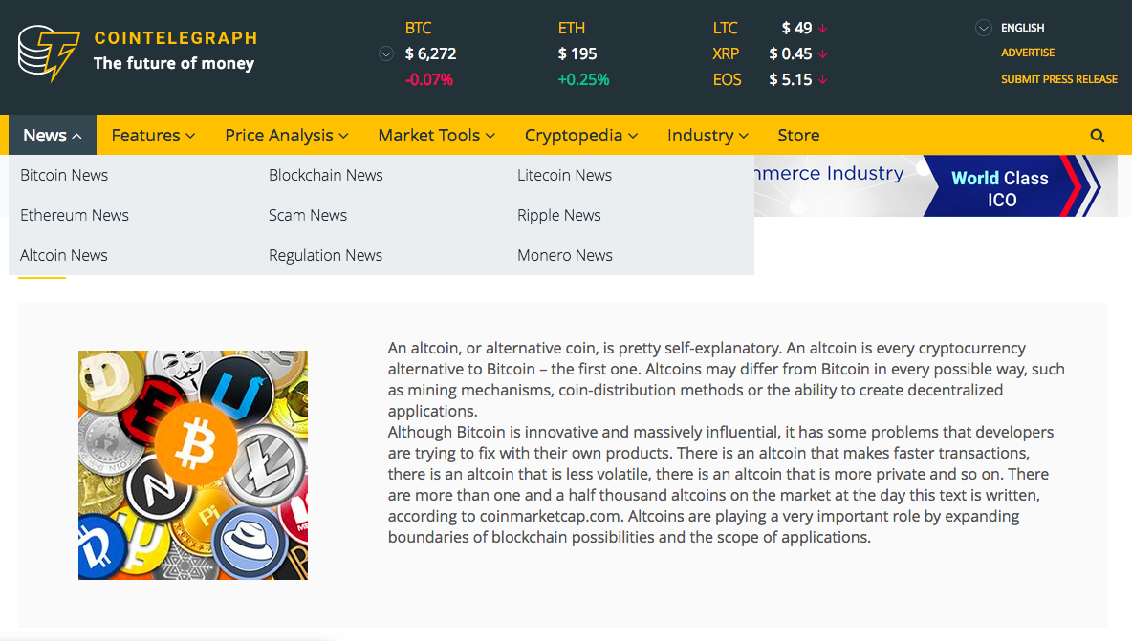
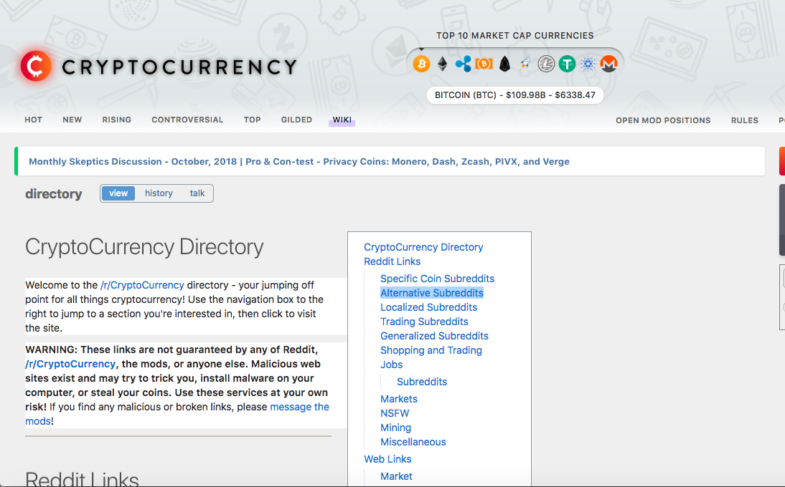
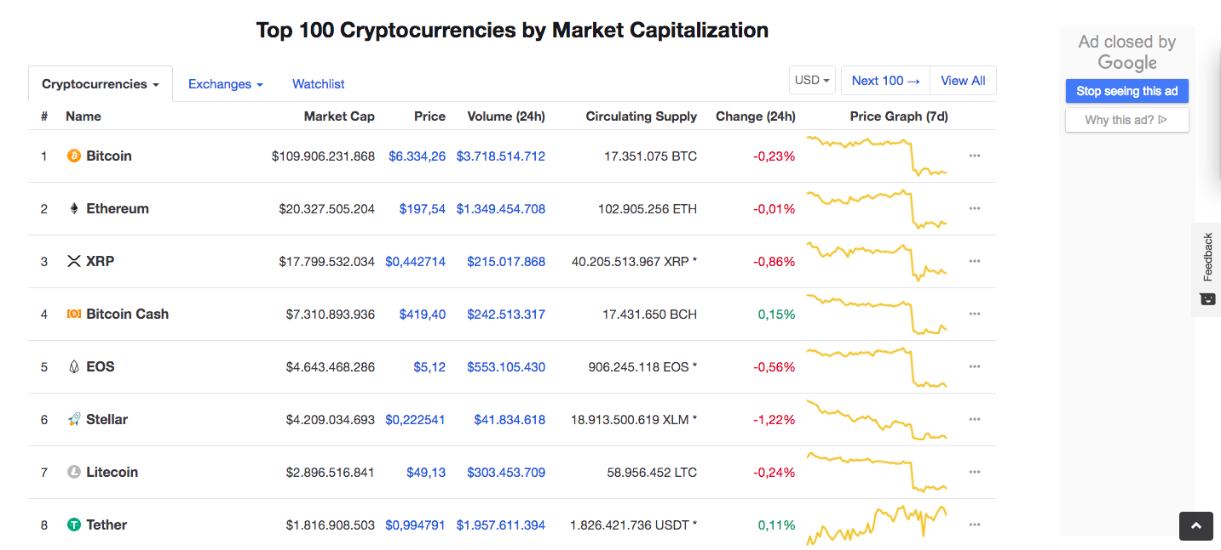


Information on the daily variation of crypto prices was collected, along with news from Cointelegraph, posts from Reddit and Dow Jones values
2
Methodology
Websites scraped
Step 1 – retrieving information from 4 websites
CoinMarketCap
Package: Scrapy
Method: Main page with information on all the cryptocurrencies trading provided the url for the historical data on each cryptocurrency
Yahoo Finance
Package: Selenium
Method: One page already had all the historical information on Dow Jones, but Selenium was needed in order to scroll down to charge all the information
Cointelegraph
Package: Selenium
Method: Loop through a list of tags of different types of news (bitcoin, ethereum, ripple, altcoin, regulation, ...). A “Load more” button required the use of Selenium
Reddit
Package: Scrapy
Method: The main page provided a list of cryptocoins subreddits. It was used to loop into each one of the subreddits “top” posts, through all the history. Information on the users who posted was aldo retrieved
Sources: CoinMarketCap, Yahoo Finance, Cointelegraph and Reddit

Slide 5

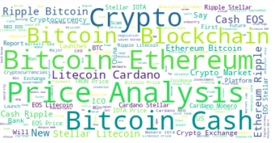
To interpret each news feed and posts from Cointelegraph and Reddit, a sentiment analysis was conducted
2
Methodology
Natural Language Processing
Step 2 – Sentiment analysis on news and posts headlines
After cleaning the headlines using stopwords and WordNetLemmatizer from nltk, wordclouds were plotted and sentiment analysis were conducted in the headlines from Cointelegraph and Reddit, retrieving the polarity and subjectivity from each news and post
Reddit wordcloud
Overview of the average and the maximum expedinture per each political party
Cointelegraph wordcloud

Slide 6
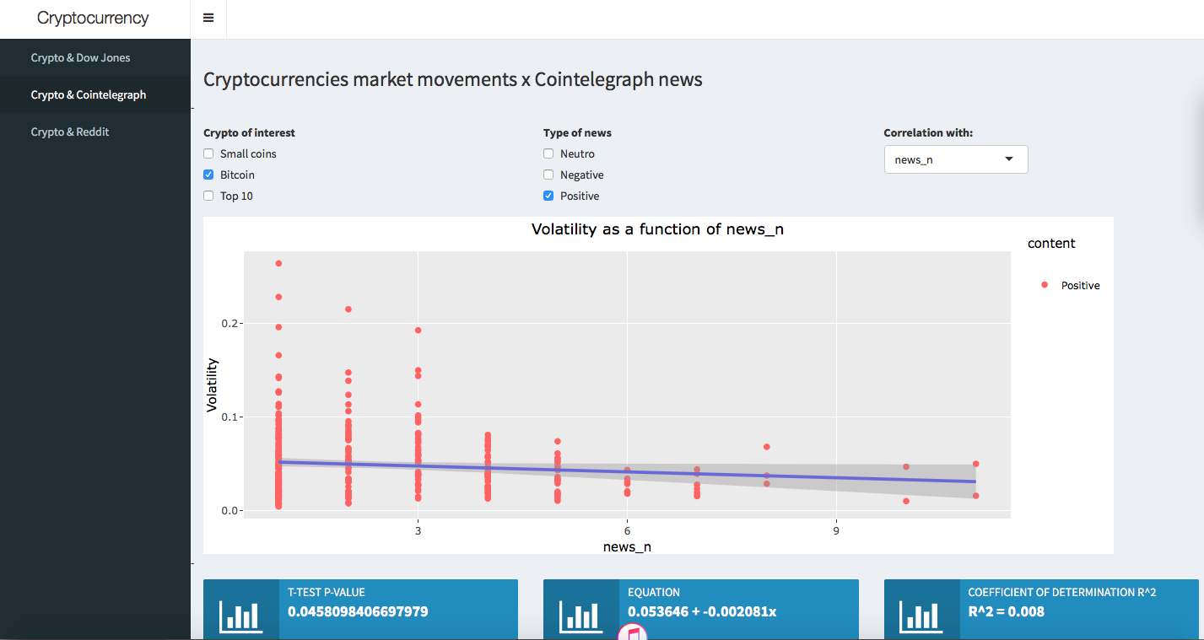
The information retrieved was cleaned and joined to allow analysis. A shiny app was developped to facilitate the visualization of the data
2
Methodology
Correlation analysis
Step 3 – Cleaning and joining data and analysing the correlation between variables
+
A Shiny app allowed fast interaction with the data and the analysis of different scenarios through simple linear regressions
+
+
https://heloisadutcosky.shinyapps.io/crypto/

Slide 7
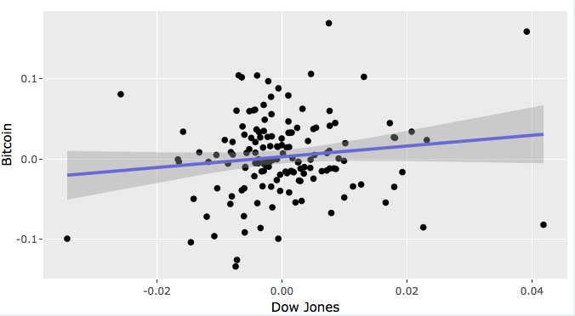

The cryptocurrency market is not influenced by the stocks market. Dow Jones movements show no correlation with Bitcoin or other coins
3
Results
Correlation between Dow Jones and cryptocurrencies daily movements
Dow Jones
US Stock Market Index – 30 of the most important industrial stocks

Slide 8
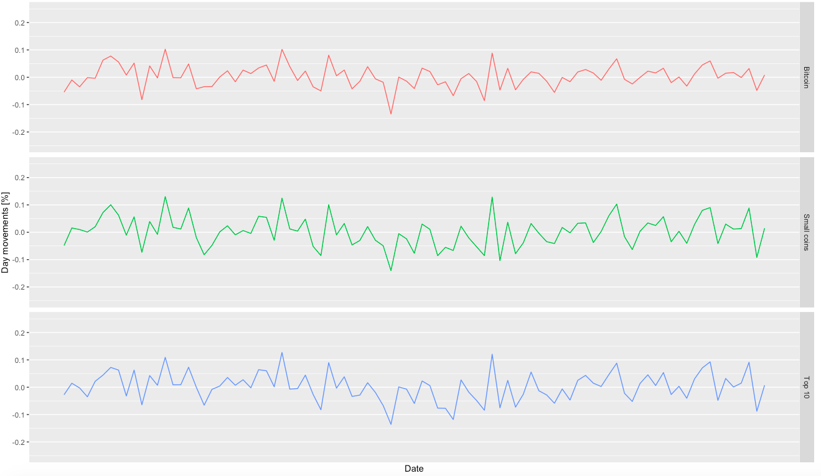
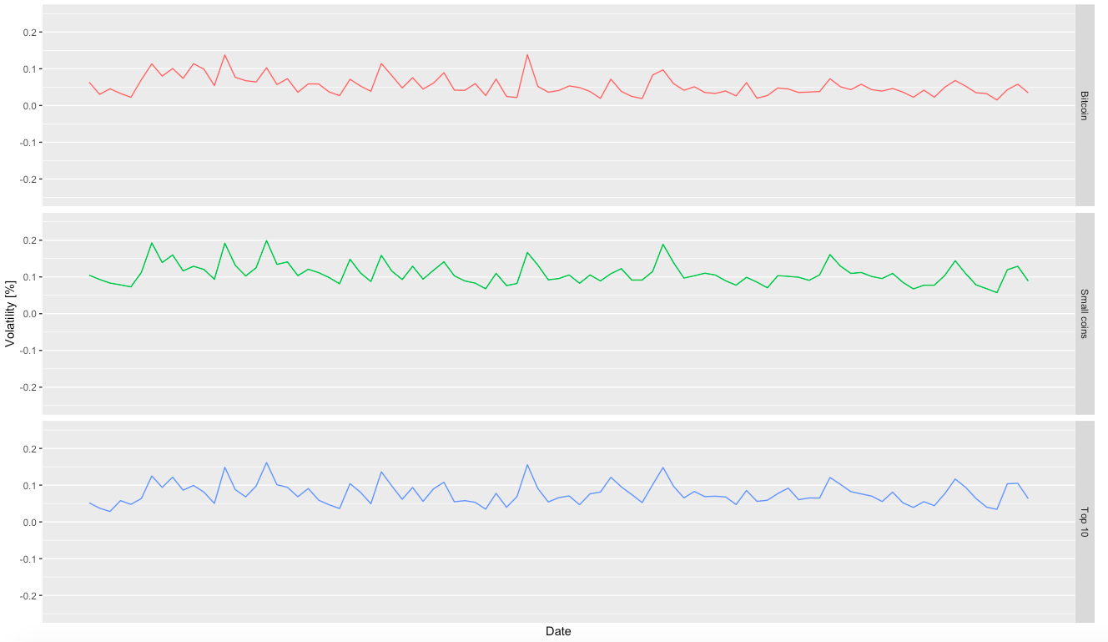
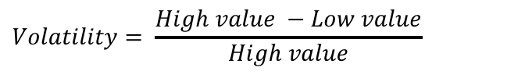
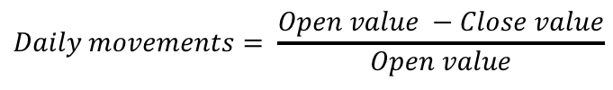
Nevertheless, most coins seem to follow Bitcoins Market movements, having high correlations on daily movements and volatility
3
Results
Correlation between cryptocurrencies groups daily movements and volatility
Bitcoin
Includes only Bitcoin, which represents ~90% of the total Market cap on crypto currency
Top 10
Includes the 10 coins with the following biggest Market caps, they sum up to x Market cap
Small coins
All of the other coins with information available on CoinMarketCap (around 2000 coins)
$$Daily movements= \frac{Open value −Close value}{Open value}$$
$$Volatility= \frac{High value −Low value}{High value}$$

Slide 9
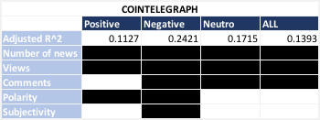

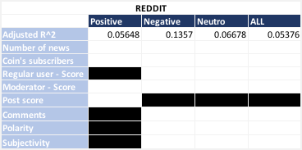
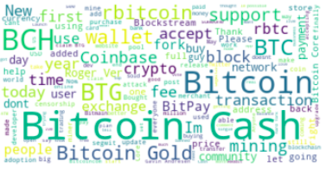
Bitcoin’s daily price variations are slightly influenced by the news on Cointelegraph and posts on Reddit
3
Results
Correlation between bitcoin’s volatility and its news
Cointelegraph
Reddit
Source: Contelegraph, Reddit

Slide 10
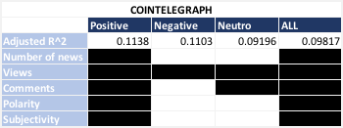
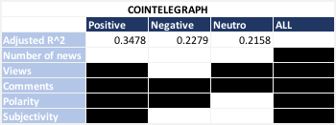
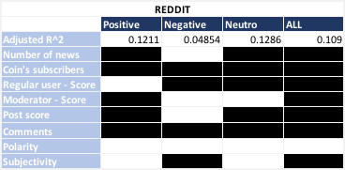
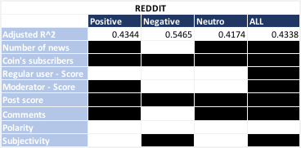
Smaller coins movement are a function of Bitcoin’s movements and their own mentions on news and social media
3
Results
Correlation between smaller coins’ volatility, Bitcoin’s movements and their news
First scenario – TOP 10 without bitcoin volatility as a variable
First scenario – TOP 10 without bitcoin volatility as a variable

